Slide 1
Graphics for Scientific Publications & Presentations
David Wilson
Sept 2024

Slide 2
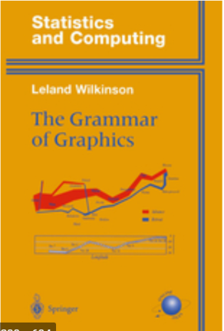
Why listen to this lecture?
Learn how to make good graphics
To avoid bad & deceiving graphics
Good graphics = readership
Scientific graphs require skill & learning
Grammar, convention, rules & guidelines
Using the software
Notice I said “graphics”, not simply plots

Slide 3
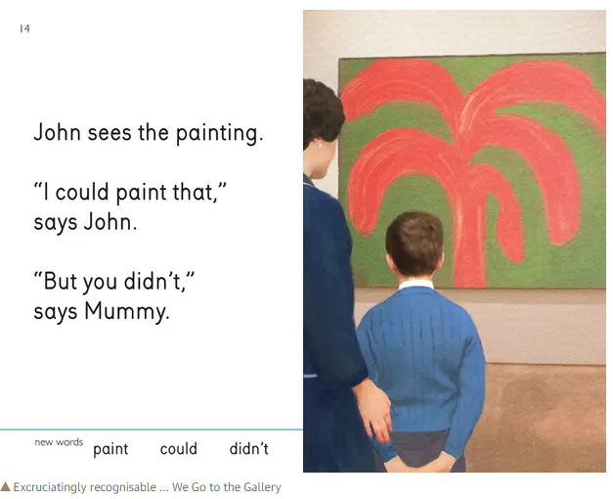
Outline for today
Looking around: Spot the good & bad plots
Basic principles
Journal graphs (plots for formal publication)
Presentation graphs
A close look at the basics
Axis, limits, captions
Colour, gradient, intensity
Aspect ratio, log plots

Slide 4
Let’s look at some example graphics …

Slide 5
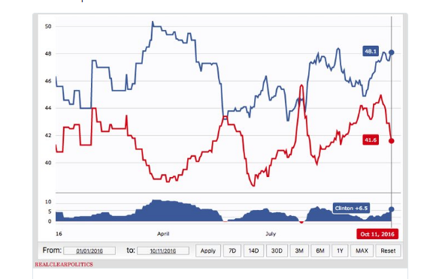
Clinton vs Trump 11 Oct 2016 (1 month before the election)
Clinton
Trump
How could she lose???
Ref: http://www.nzherald.co.nz/world/news/article.cfm?c_id=2&objectid=11727277

Slide 6
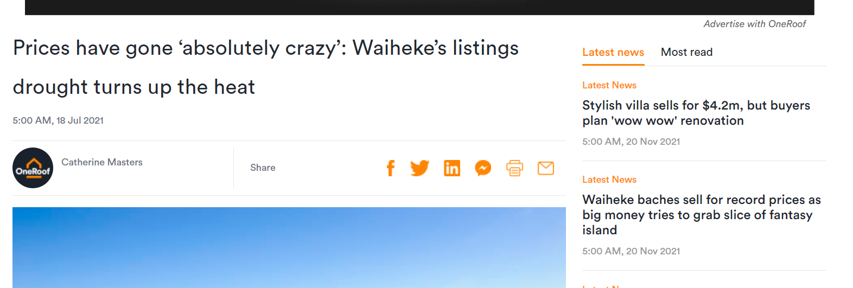
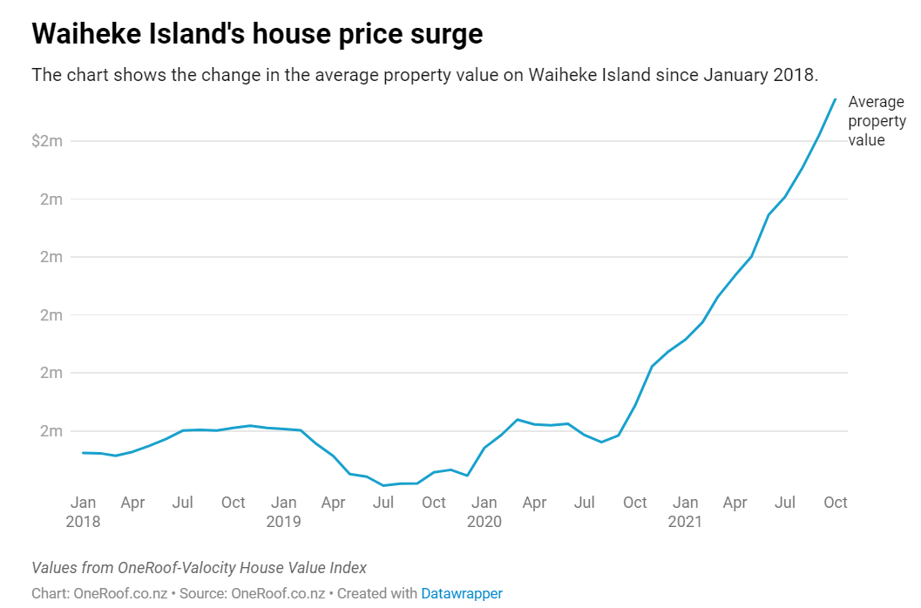
New Zealand Herald, Nov 2021

Slide 7
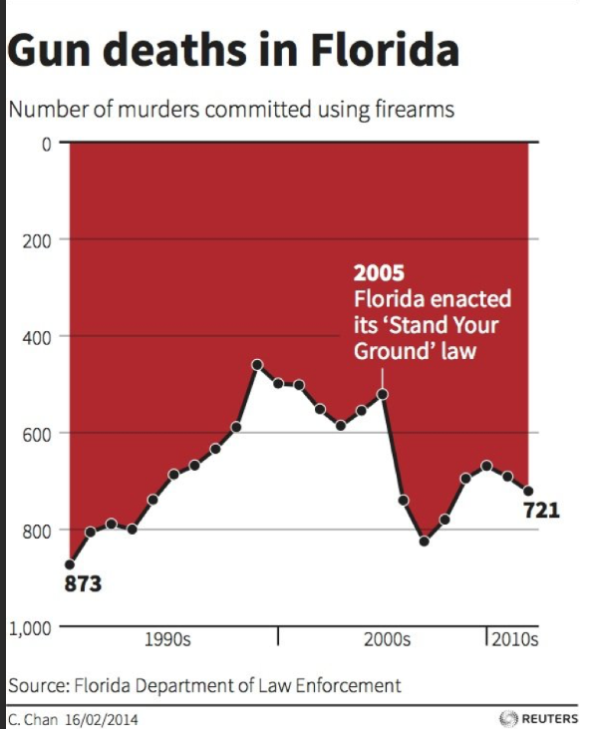

From Reuters News:

Slide 9
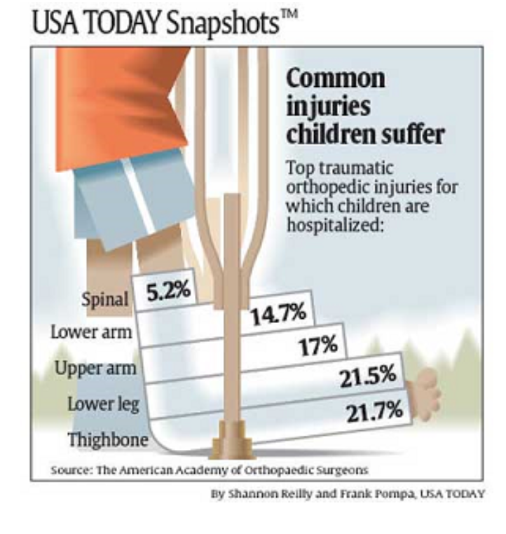
21% of children get lower leg injuries
Seems a lot?
Even worse: 5.2% get spinal injuries (!)
Actually, the real figure is 0.0000003% (based on 2000 injuries in 74 million)

Slide 10
What about “scientific plots” ?

Slide 11
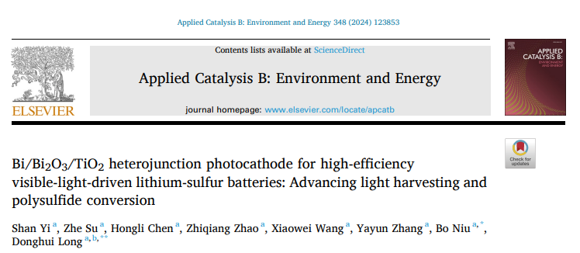
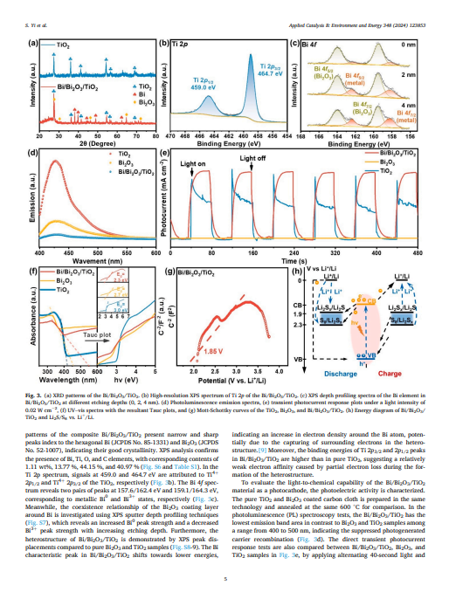
Plots for Journals & Theses
Audience are professionals
Assume that the reader has the book open in front of them

Slide 12
Comments please

Slide 13
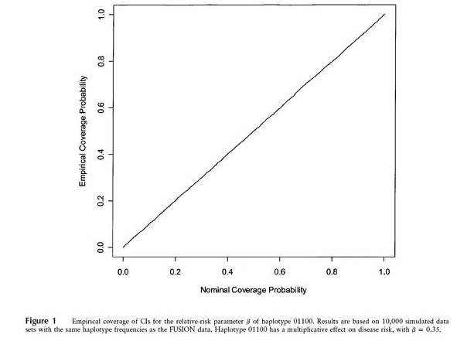

Slide 14
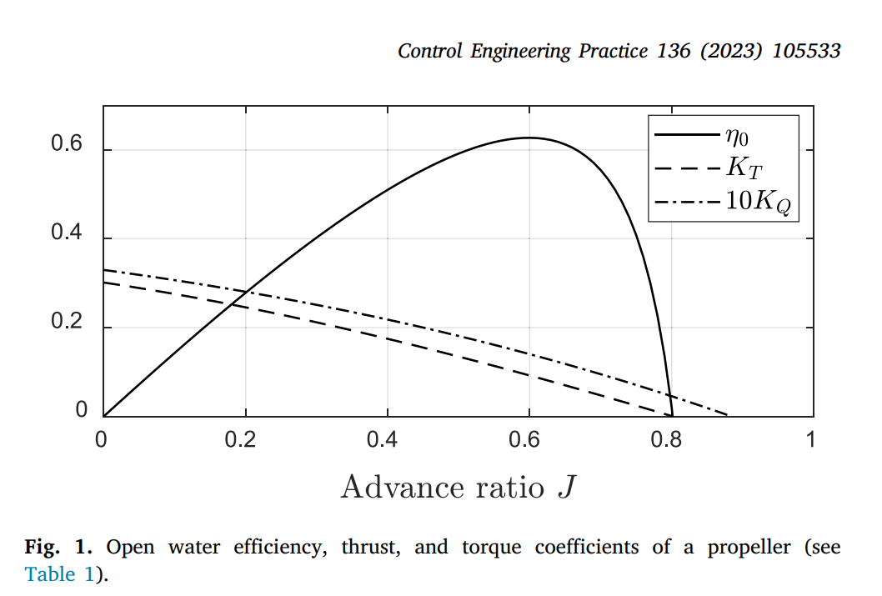
Basic (x,y) plot(s)
Data density is lowish
Y axis quantity ?
Look at the caption: Which curve is which ?
Dashed lines too similar (use colour?)

Slide 15
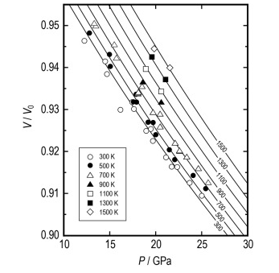
I quite like it!
Aspect ratio seems reasonable
Curve annotation on the curve, nice
Black & White, but still …
Point shapes carefully chosen
Notes:
Quite nice, classical, but black & white
Note numbers overlayed

Slide 16
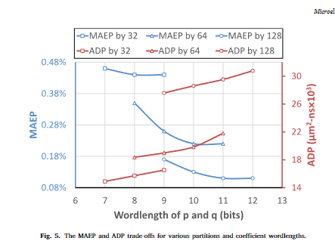

Slide 17
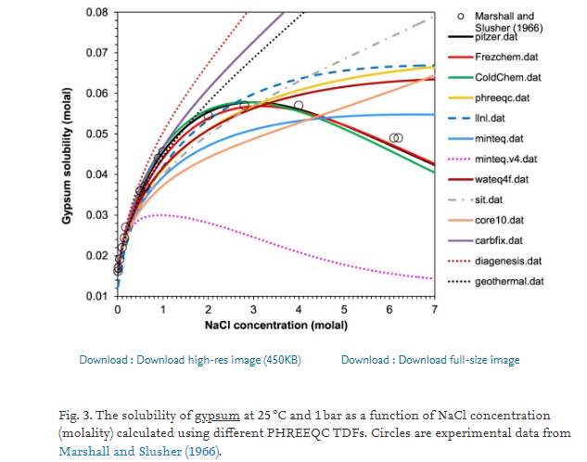
Plotting lots of data, perhaps too much

Slide 18
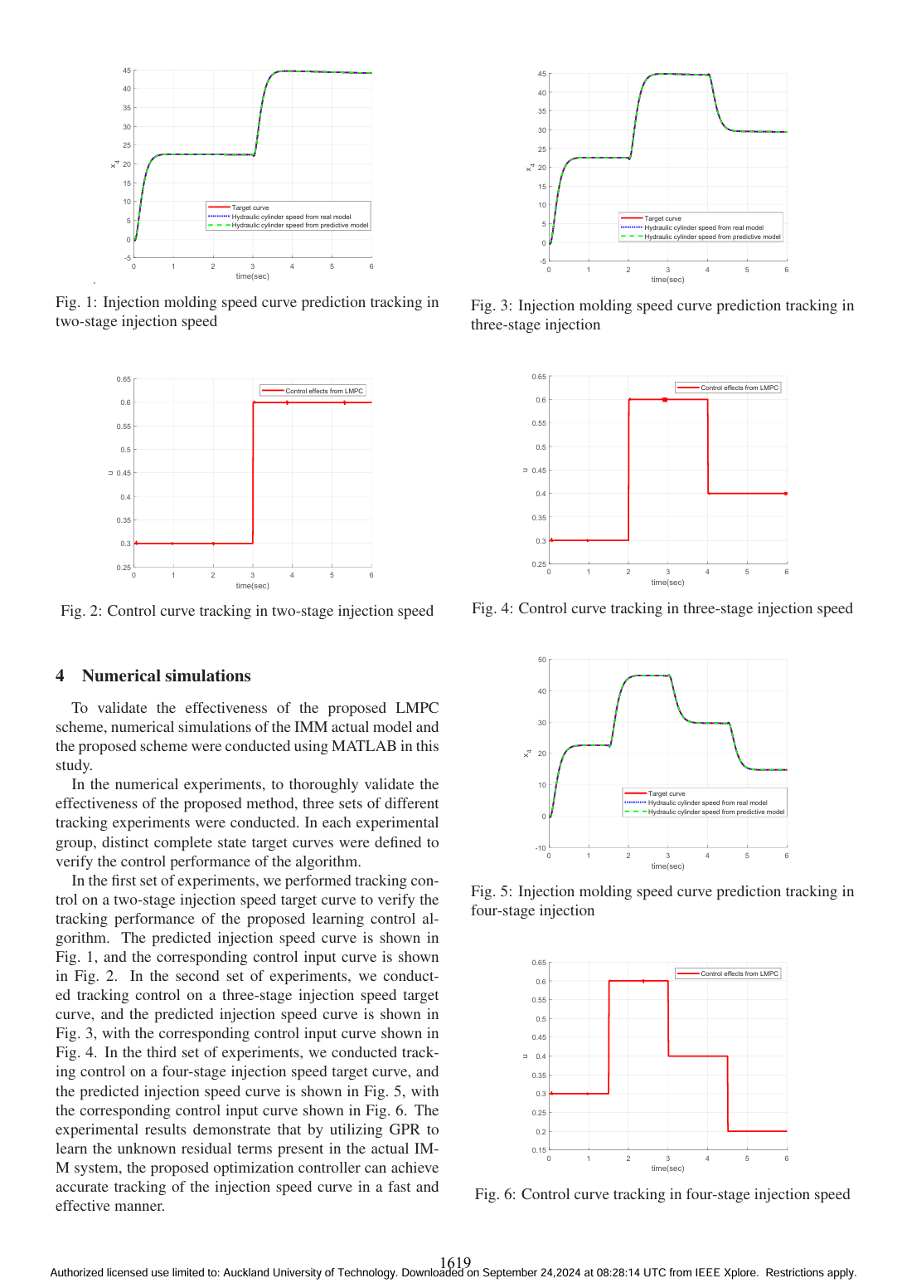
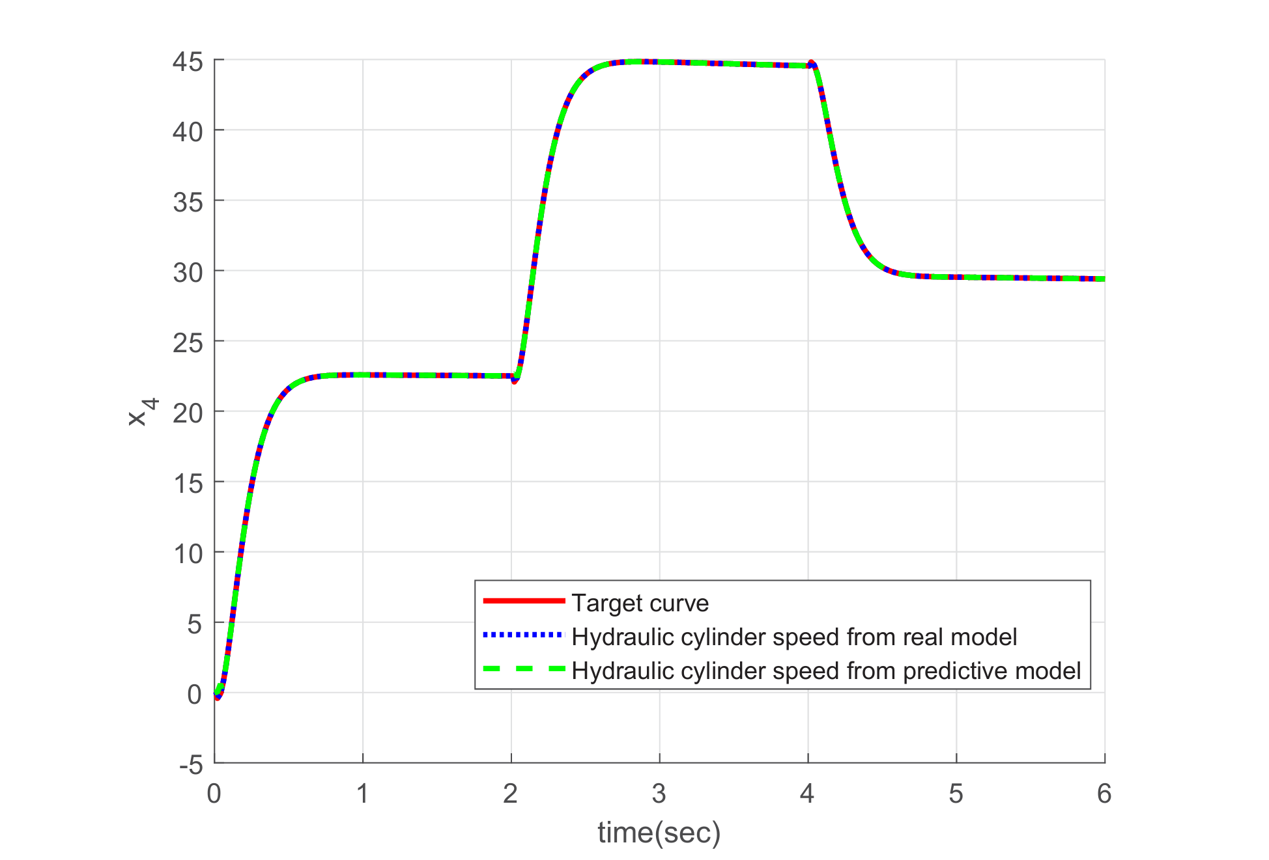

Slide 19
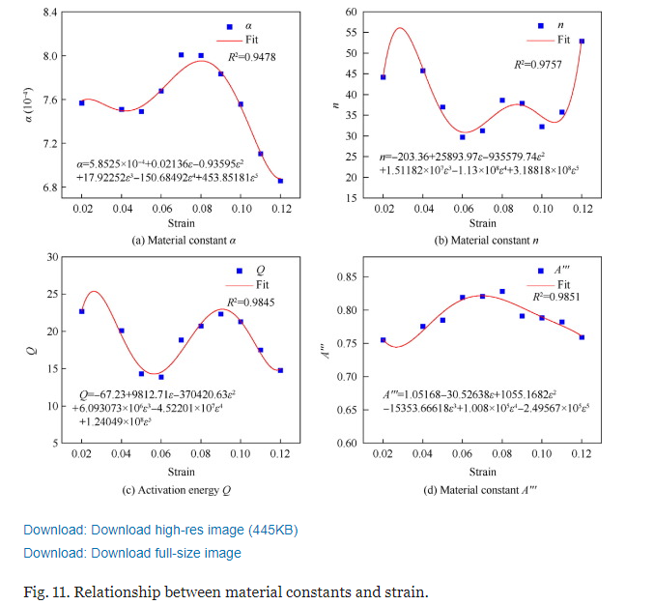

Slide 20
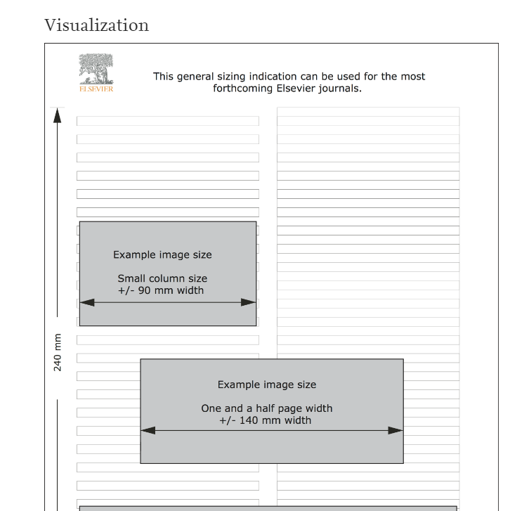
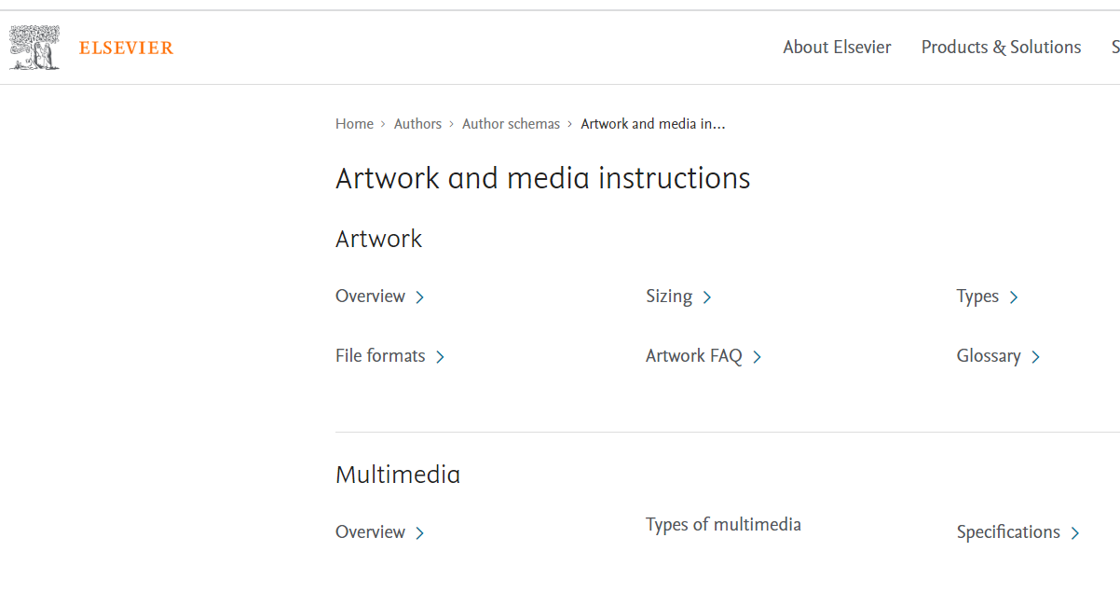
General principles: Journal plots
Read the journal’s rules
Black/white, grey or colour?
Fit in a two-column format journal article
Data are markers, models are solid curves.
Label everything, write long captions
Annotate on the figure
Keep data density high
Default plots are often “spindly”

Slide 21
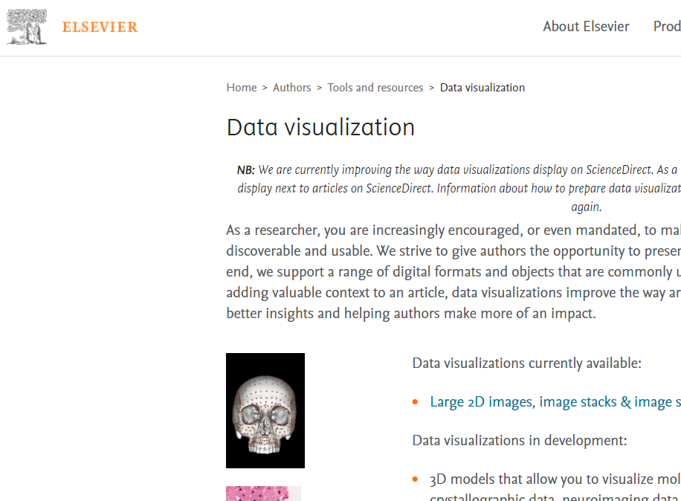
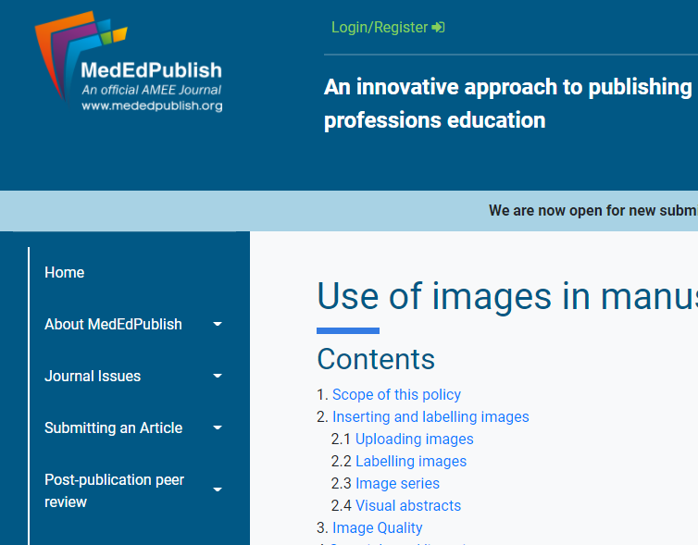
Specific journal graphics requirements
Non-negotiable rules
Elsevier Data visualization
https://www.elsevier.com/authors/tools-and-resources/data-visualization
https://www.mededpublish.org/Policies/Use-of-images-in-manuscripts
How to write a graphical abstract
https://mindthegraph.com/blog/create-effective-graphical-abstract/

Slide 22
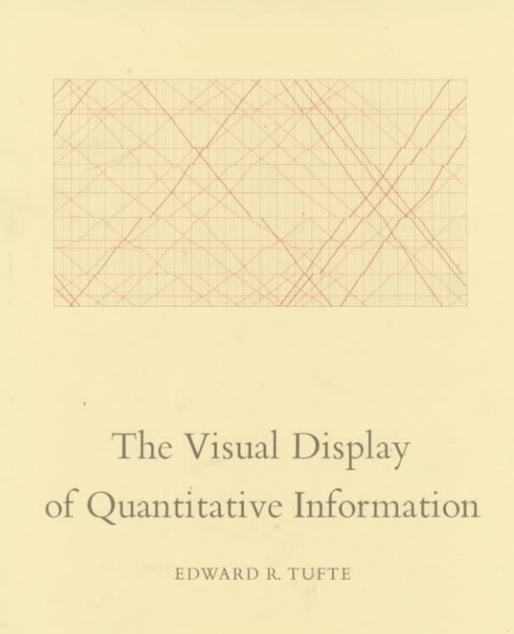
Graphical Excellence
Is the well‐designed presentation of interesting data
A matter of substance, of statistics, and of design
Consists of complex ideas communicated with clarity, precision & efficiency
Truthful results
Distortion-free
High # of ideas in a short time
Efficient, minimise chart junk
Yes, it is unstated

Slide 23
Principles of good design
Always graph your data –
A graph will obviate the need for any further analysis.
Will the reader simply scan or do a detailed analysis?
Don’t lose sight of the purpose of the graph when you are drawing it.
Make sure that the graph is complete.
All axes must be labelled. There should be a title on the graph.
There should be a high data to chart ratio.
This means that the data points should be clearly visible,
not be overwhelmed by axes, titles, reference lines, and chart junk.
Grid lines should not be too dark, missing, or not relevant to the graph.
Ref: Schwarz, Tufts

Slide 24
Principles of good design (cont’d)
Overall presentation of the graph.
The points on a plot should be spread over the area of the graph without being shoved into one corner.
The axes scales should be appropriate. (log-axis perhaps)
Where is the 0 point on a graph?
Bar charts should always be anchored at zero.
Use different plotting symbols or line-types to differentiate among groups on the graph.
The independent variables is usually plotted on the X-axis; the dependent variable usually on the Yaxis.
Ref: Schwarz, Tufts

Slide 25
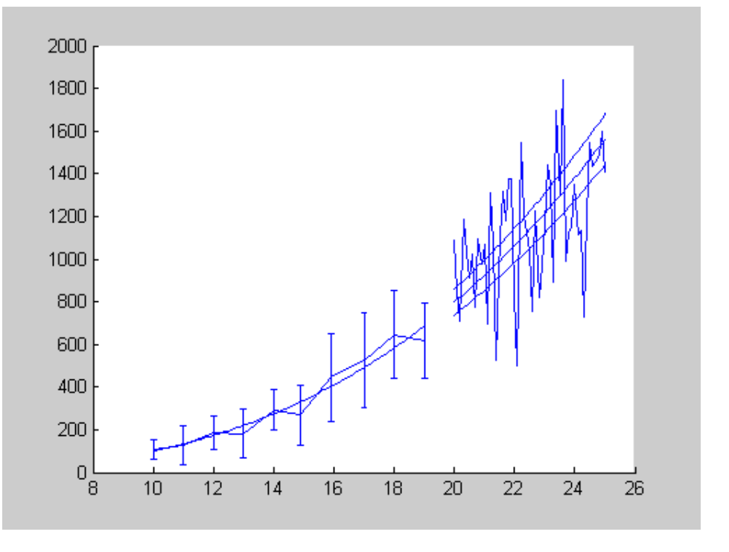

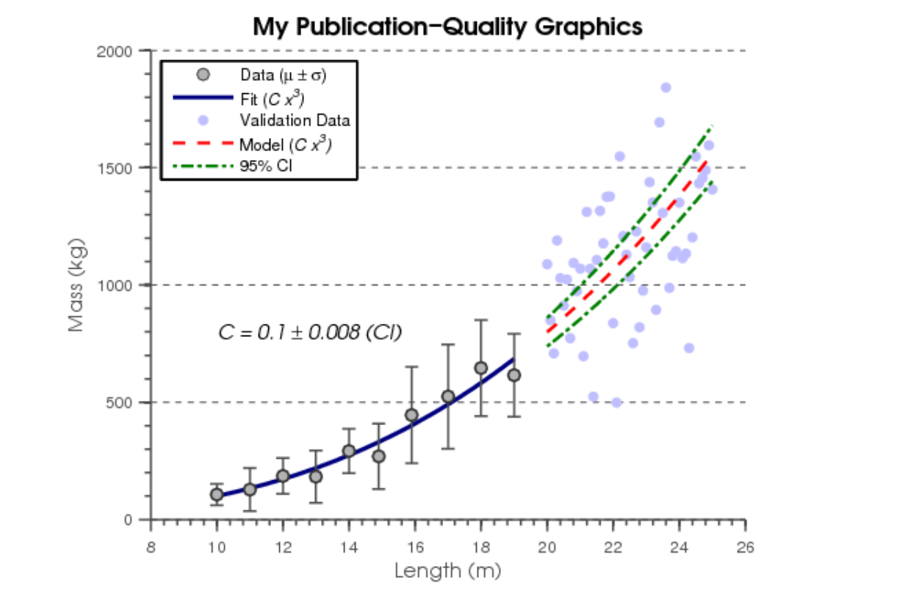
Before we begin: Using good graphics software
I hear you say:
Yes, but my software package can’t do those plots
No excuse: Get one that can.
Often “out of the box” defaults are ugly
Basic “business” often to simple & cute
Use R and/or matplotlib
Various packages are designed to work better
Start with this plot, and improve it!

Slide 26
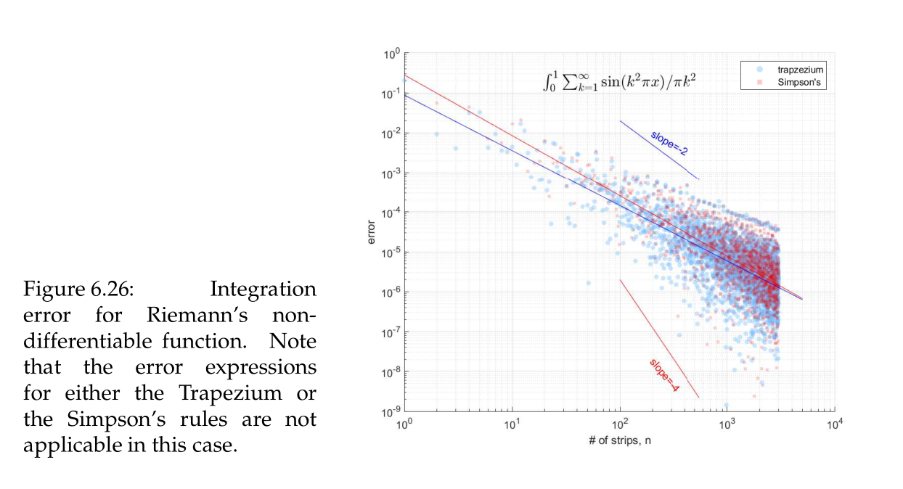
Get the figure basics right
All plots need
Figure #
Axis labels & units
Decent long caption
Optional
Colour
Sensible & consistent
Detailed caption
Grid lines
In this case we describe the plot in the caption
Grid reinforces the fact that it is a log plot

Slide 27
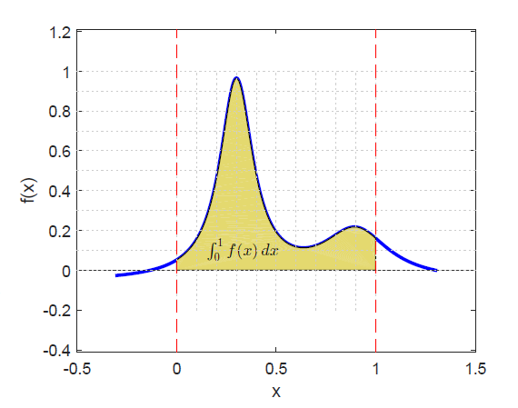
Keep the background grid off,
Or if you really need it
in light grey
Grids get in the way
But required for:
Integration
Comparing areas
Values discretised ?
In this case we want to stress the quadrature grid,
“counting squares”

Slide 28
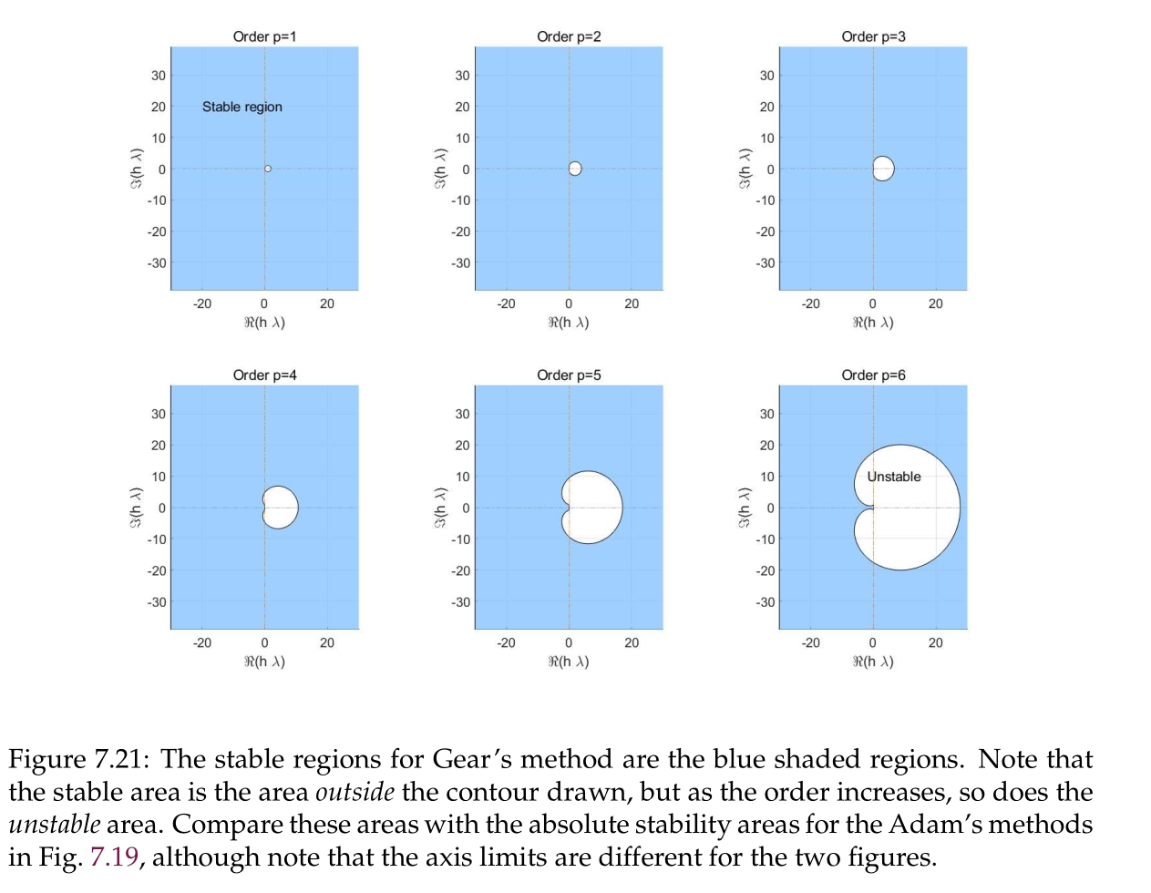
Get your axis scales right!
We need the same scales to compare
But I can’t read this !
(Tough)
Informative caption

Slide 29
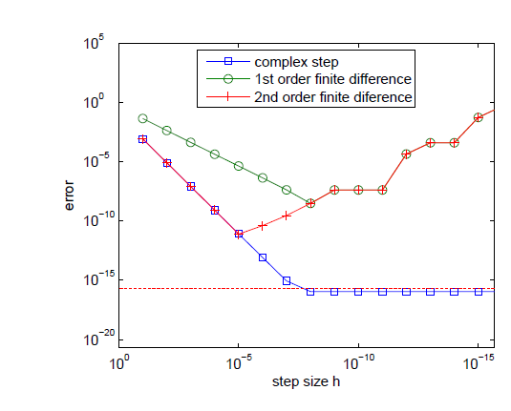
Axis direction: not always ->
Increasing precision requirements
X-axis decreases to the right
Do I have to turn my head?
Am I violating expectations?
Look carefully here

Slide 30
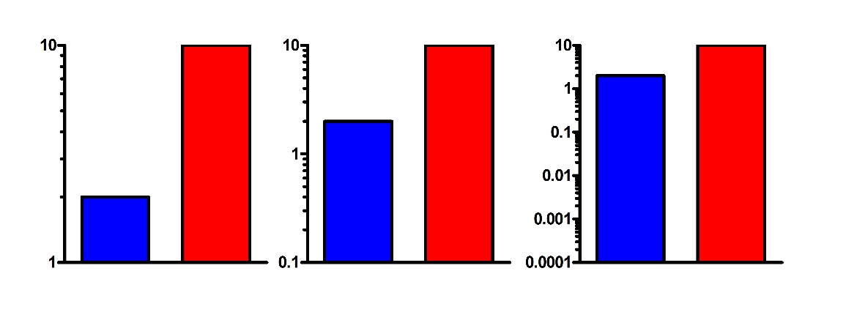
Three log plots
Each plot shows the same data !

Slide 31
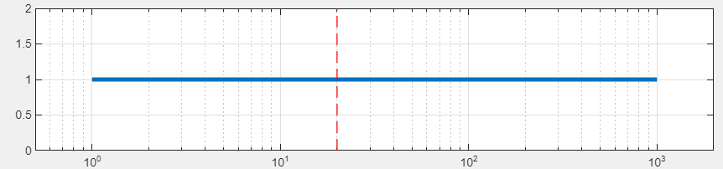
Quiz: Mark on the log scale where 20 lies
1.0
1000

Slide 32
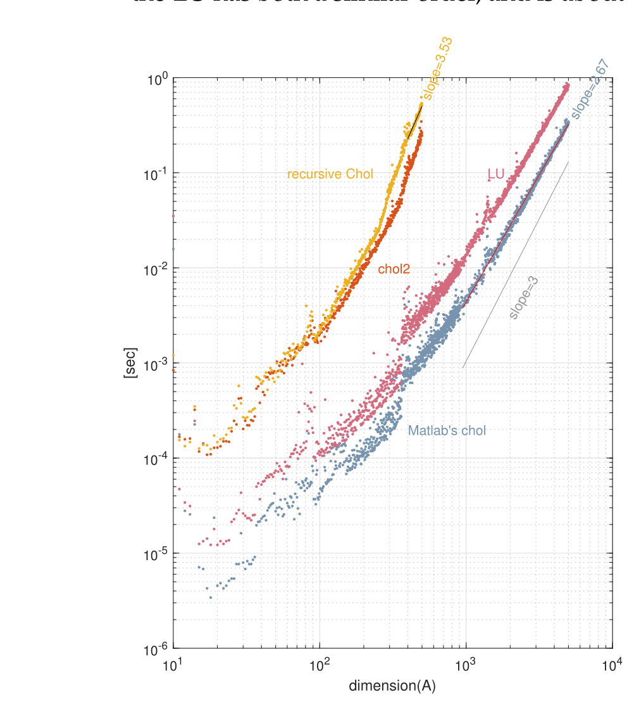
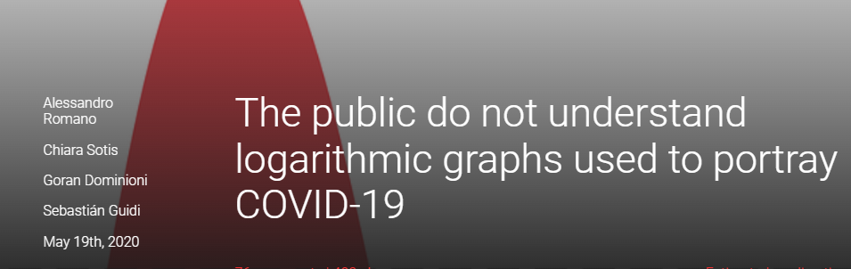
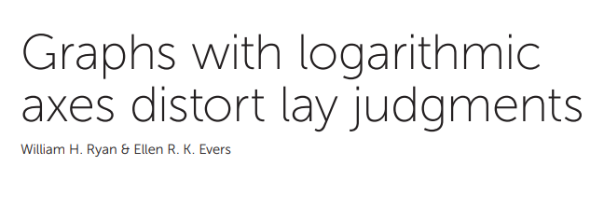
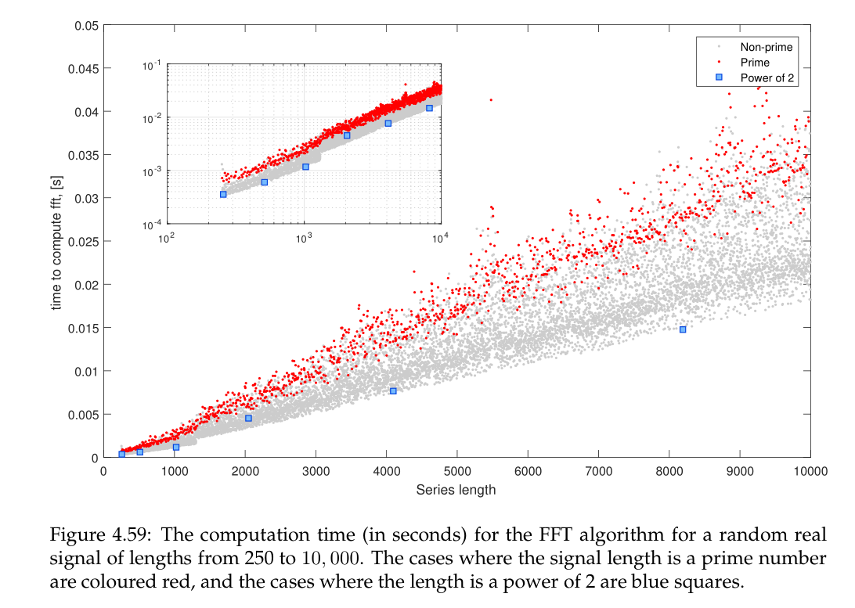
Nobody can read log plots correctly!
So put the slopes on them as well!
Insert log plot too!
Rotate with caution!
Don’t crash into axes
Put in the log grid to highlight the log

Slide 33
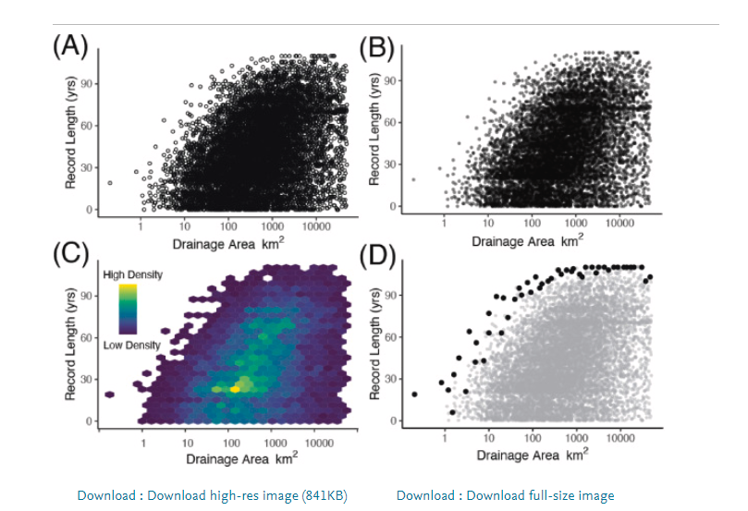
Simple plot design: Data density
Need to display lots of data
Convey data density
Display each data point?

Slide 34
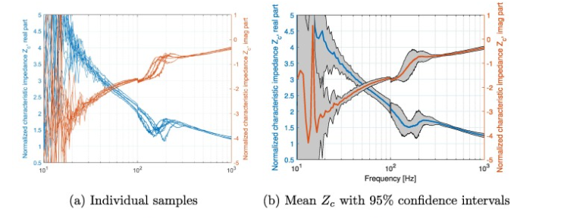

Slide 35
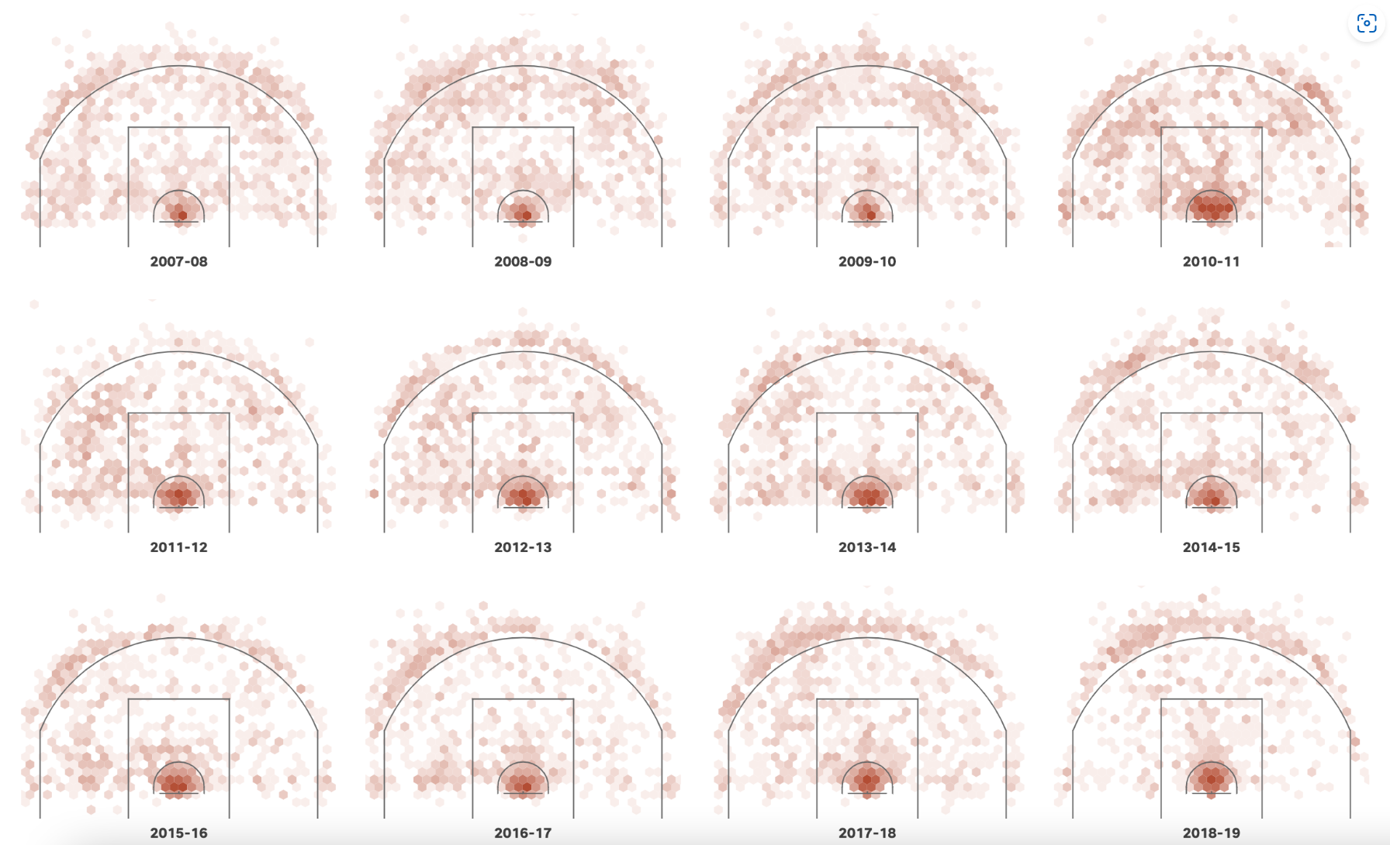
LeBron James has captured the scoring title. We visualized every shot. by USA Today

Slide 36
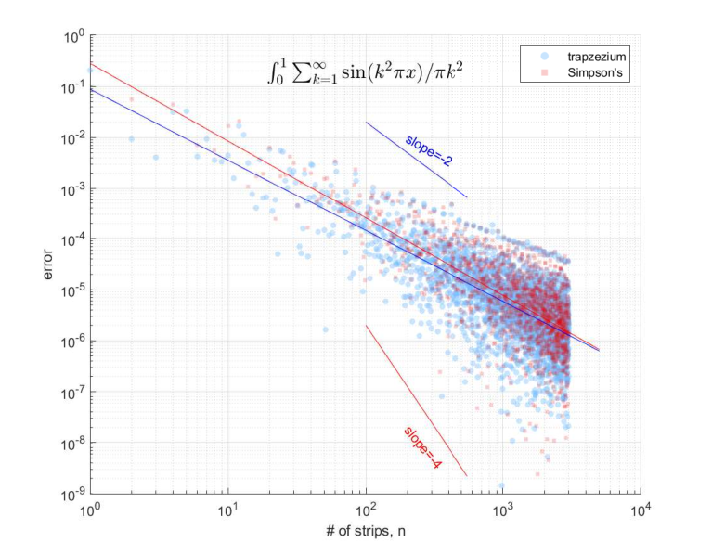
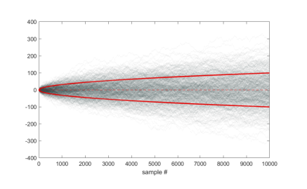
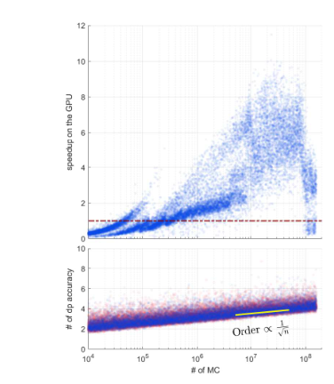
Data Intensity
Difficult to display this any other way
Exploit density by using RGBA (“A” for alpha)

Slide 37
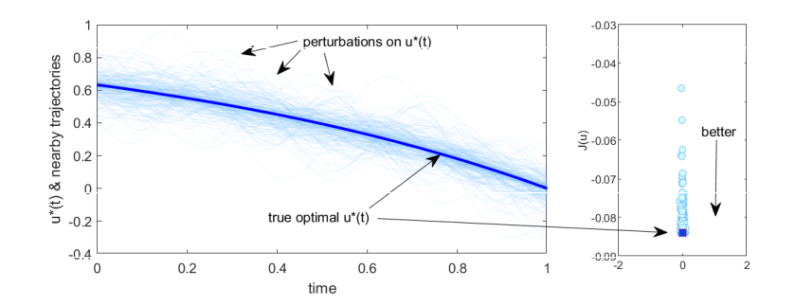
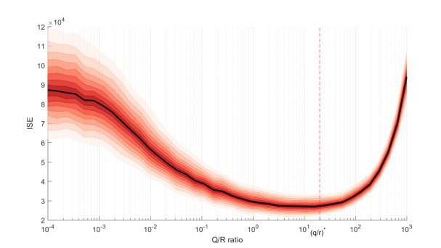
Plotting lots of data & the confidence to go with it
Sometimes we do want to plot all the data, but really we just want to convey the data density
Use transparency, but carefully

Slide 38
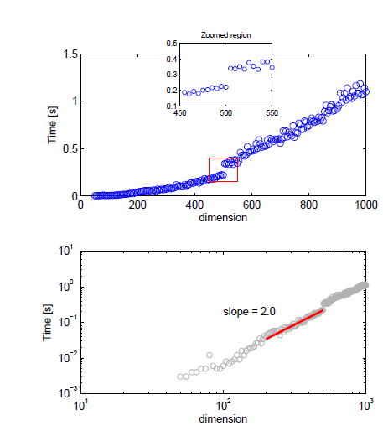
Do you need to plot all the data?
Get a thick pen & over write the important trends
Want to give an impression of lots of data, but don’t need to go overboard.
I realise data is precious, and you want to plot everything, …

Slide 39
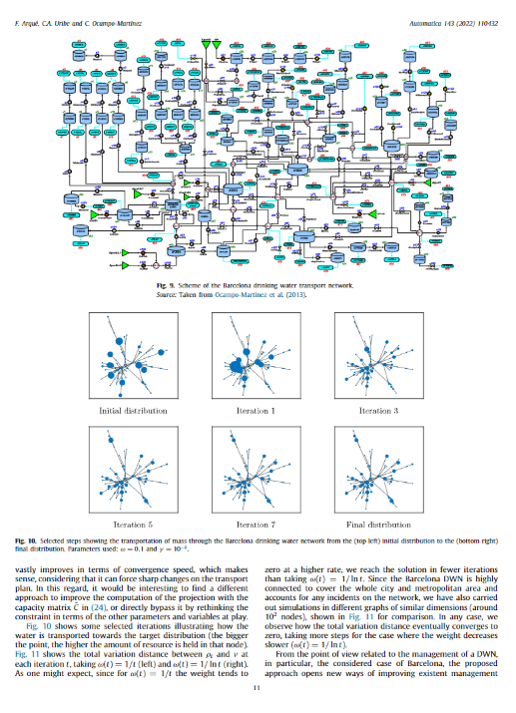
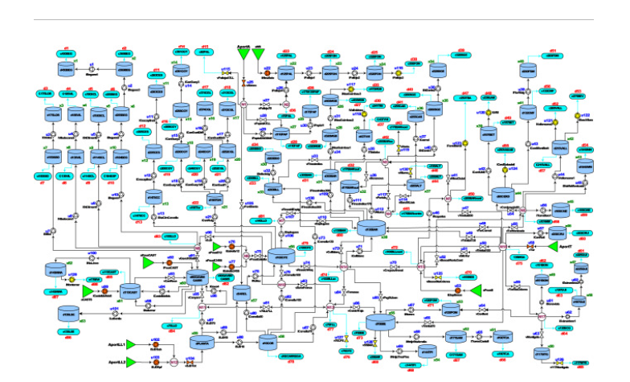

Slide 40
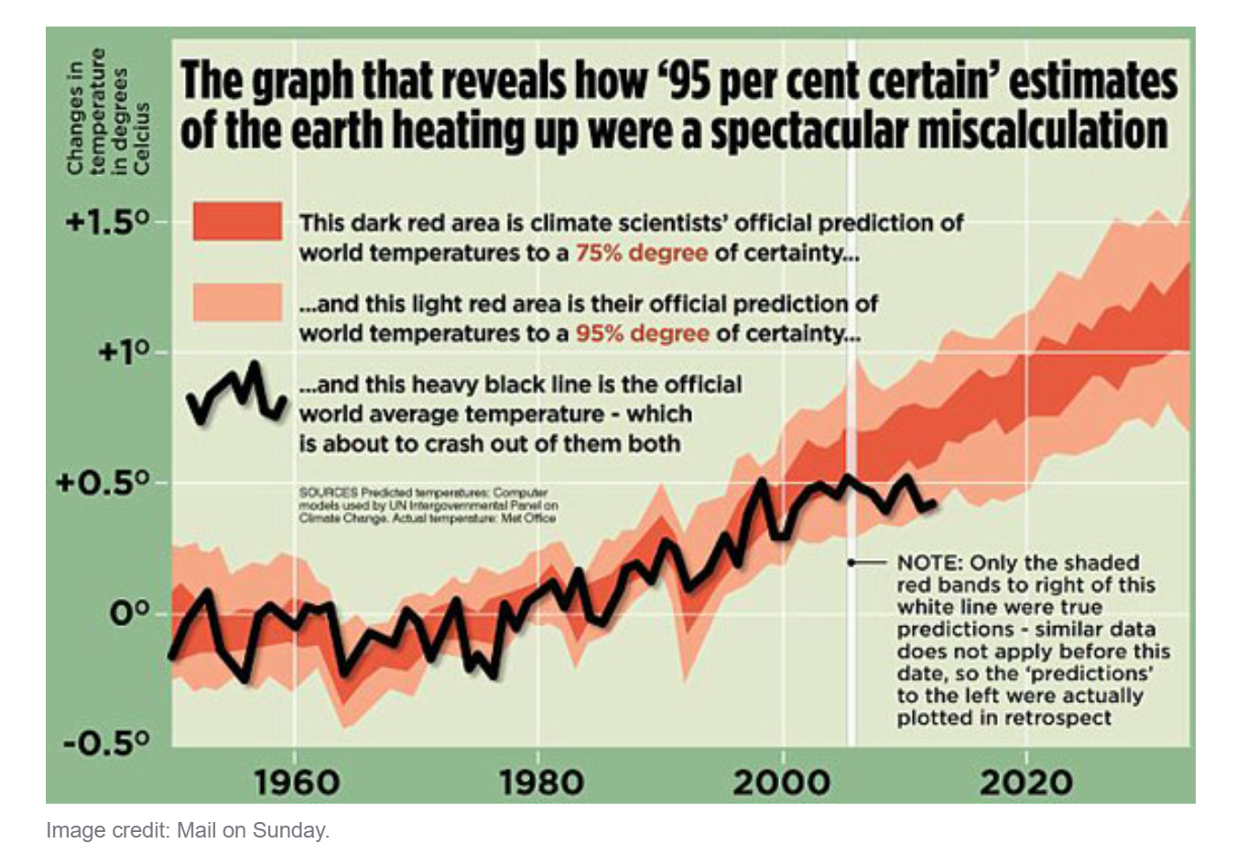
Global warming? (Newspaper: Mail on Sunday)
This graph makes two errors:
The graph is showing air temperatures. This is a very poor measure of global warming as much of the heat ends up in the oceans.
This is a very short term graph. You can’t make good predictions based on a little data. A better graph for global warming would show the trend since the industrial revolution.

Slide 41
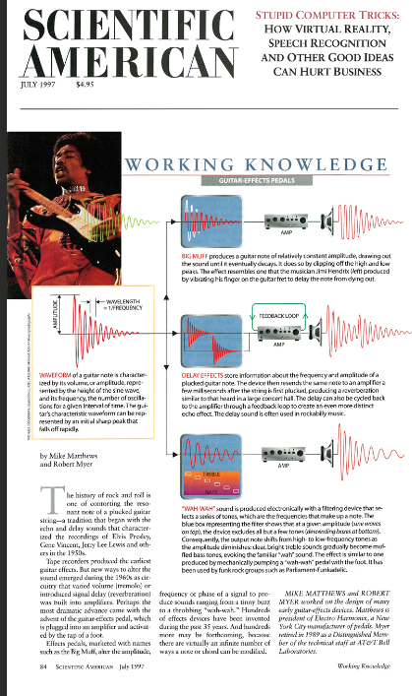
Some illustrative examples of scientific plots
Let’s look at the good and the reasonable
Different perspectives
Advice that follows is exactly that, not gospel
Basic plots.
(Not overly complex “glossy Scientific American” style)
Don’t have the skill, or time, for fancy graphics (infographics)
Probably not expected by the audience
Notes:
Scientific American usually has heavily customised graphics with illustrations which is more in the realm of infographics. This is not possible without major investment in time as well as some serious digital arts skills. Nevertheless, it can still be used as inspirational material to get creative about how to best represent your data. The colours and fonts should also be noted.

Slide 42
More complex plot design:
Requires some artistry & good software
Consider the constraints of your “canvas”

Slide 43
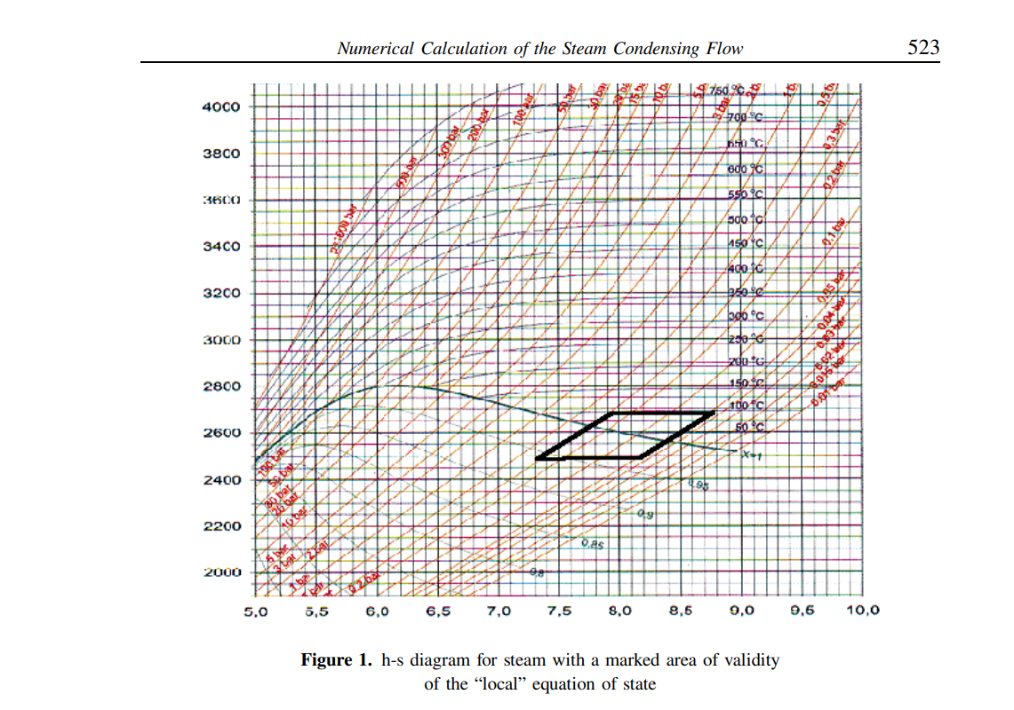
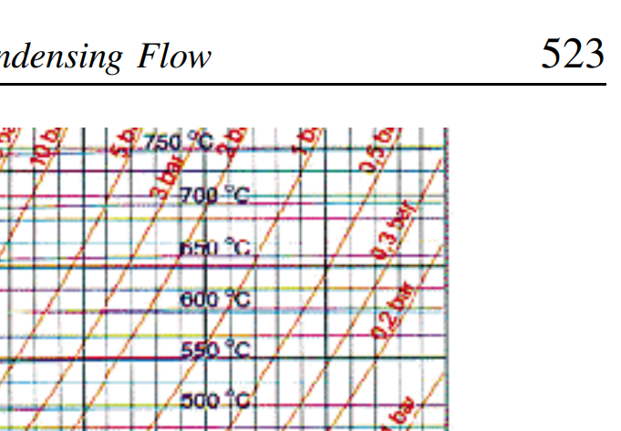
Take care with your reproduction ?

Slide 44
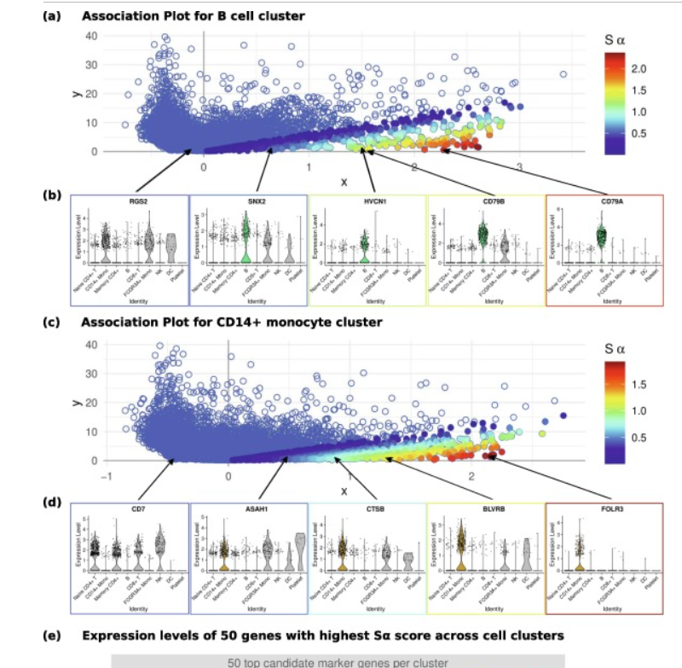


Slide 45

Simple plot design: Stacking plots
Multiple plots
Want to compare things

Slide 46

Comparing things: Stacked plots
If you are going to compare things, then stack them
Don’t repeat the x-axis labels
Make sure it is easy to compare with vertical lines

Slide 47

Place the error plot underneath the actual plot
But make it fatter
Don’t repeat the x-axis again
Critique:
Colours are odd
True curve should be a very different colour

Slide 48


3D plots & surfaces

Slide 49


Slide 50



Slide 51



3D plots: Apply sparingly
Never draw 3D plots when the data is 2D!
i.e. 3D effects (Word art, Yuk !!)
Cannot “read off” the data on a 3D plot
May be visually confusing
Height info:
Contours or something else
Phase & mag for complex functions

Slide 52

Common errors in plots
Wrong graph type. Think about what you want to present.
Trends are best displayed using lines.
Compositions best displayed using segmented-bar-charts.
Missing text.
All tick-marks and axes must be labelled.
The graph needs a title & sensible legends
Inconsistent scale.
The scale must be constant across the graph;
Don’t change the increments between tick marks.
Most people read increasing scales from left to right and from bottom to top.
Comparative graphs
must be plotted on the same axes to facilitate comparisons.
Misplaced zero point. Most people assume that the zero point is at the bottom of the graph. This can give a very misleading impression of the amount of change present in a data series.
Ref: Schwarz, Tufts

Slide 53


Common errors (cont’d)
Poor chart effects.
Shading or 3-D effects are often added to liven up a graph.
In most cases they are useless since they distort the graph and add little new information to the story.
3-D effects are particularly poor as no information is being added; it is difficult to read the chart values;
Confusing of area and length.
If you make a picture twice as large, it looks as if it has four times the area!.
Too much precision.
We’ve all seen graphs reporting that the amount of money raised is $13,456,234.32.
Most people can’t distinguish objects at a resolution better than one part in a hundred.
Ref: Schwarz, Tufts

Slide 54


Plots in plots
Have content at different scales
We need to re-focus
Zoom the plot, but don’t need a new plot
Too much ?

Slide 55

Advanced advice
Don’t bother with scales if you don’t need them
But be careful !
See rule #1

Slide 56

Draw attention to the important bits
Infeasible region is not entirely unimportant
Shading is transparent (i.e. “see through”)

Slide 57


Plot Aspect ratios
Square plots should be “square”
45 degree lines
Does the slope mean something?
Circles not ellipses
Actually, above plot is not strictly correct

Slide 58

“Banking” to 45º
CO₂ levels increase
Famous curve !
But what else do you see?
Ref: http://vis.berkeley.edu/papers/banking/2006-Banking-InfoVis.pdf

Slide 59



Slide 60


Long time series

Slide 61

Long time series
(Could wrap them)

Slide 62

Aspect ratio
This is a full page from a book.
Note the two classic “long” time series

Slide 63

Colour
No, I don’t like the background shading either

Slide 64

Sometimes I wonder why they bother ….

Slide 65

Colour is great!
Colour adds interest & dimension
Colour allows another dimension
Google “scientific color maps”
(no rainbows)
BUT
Many Journals don’t like it
too expensive
Some people are colour blind, so choose carefully

Slide 66

Warm colours dominate, Cool colours recede

Slide 67


Slide 68




Slide 69




Colour maps
Collections of colours
Need colour to enhance graphics
Don’t use “rainbow”
Default is now parula
This is the colour map
Perceptionally uniform
How to we account for Colour blindness ?

Slide 70


The colour bands are artificial
Note that this colour map introduces “bands” to the human eye
XKCD #2537

Slide 71



Rainbow ?
Can you see the bands in the colours?

Slide 72


Make the colour map relevant (& expected)
Wildfires in Chile
Got to be reddish right?
High rainfall in Belgium
Got to be blue right?

Slide 73


Getting colour gradients right
Ensure that the colour order is obvious
Even when reproduced in grey/scale
Don’t use rainbow
Do use perceptually uniform
Often the colour needs to be a “log” scale
Surface is very “flat”, so can’t see the real actual minimum!
Note the diverging scale

Slide 74


Use a sensible, intuitive gradient of colours
Note that the normal distbn (blue) is quite different from the t-distributions (orangy)

Slide 75



Consistent (& attractive) colour gradient
Figure 6
Figure 7

Slide 76


Notes:
Here is a Reuters graphic showing unemployment rates in Europe using a barplot combined with map. The colour scheme is a bit strange in using different colours for sequential continuous data. The title and number font may seem a bit too bold and black (85% gray). But, the graphic is still quite appealing in general. The eurozone countries are marked by crossline shading. Neighbouring countries are grayed out to be less prominent but still puts the subject in context.

Slide 77
Colourblind readability
https://community.esri.com/t5/esri-training-blog/designing-maps-for-colorblind-readability/ba-p/1139017

Slide 78



Colour in equations & text
Of course, be prudent and restrained
OK, so be careful
Be consistent across your document
My annotations are blue & “handwritten”

Slide 79


Use colour to mean something in your equations

Slide 80


Graphics need not take up too much space.
Place them where it’s really needed
Actually plots can be quite small
Sparklines

Slide 81

Is the information density too high?
Or is that the point ?

Slide 82

In-line plots: Sparklines (cont’d)
Small “inline” trends (Due to Tufte)
Sparklines are “datawords”

Slide 83



Slide 84




Mathematics & code
Make it readable
Use LaTeX

Slide 85

But don’t “show off” your maths ability …

Slide 86


Photos in scientific publications
Too much extra info. Do we really need to see the computer?
Odd (lazy?) perspective.
Give a block diagram as well?
Right to left?
Here, we are not talking about fraud and photo duplication in science. Whole new story.

Slide 87



More photos …

Slide 88

What we didn’t talk about …
Presentations
Graphical abstracts
https://mindthegraph.com/blog/graphical-abstract-for-elsevier/#.YoW806hByUk
4D plots and more complex scientific posters
Tables
Overall graphic design
Best visualisation: flowingdata.com

Slide 89

So what about presentations?
Watching someone reveal the bullets …
Like pulling teeth
Much research about the optimum # of bullet points
7 ± 2
Or even zero (Tufte)
Background colour
Used to be dark blue (limitations of projectors)

Slide 90

Presentations are mostly visual
In contrast to a paper, or a simple interview, you present your work and yourself
People remember good presentations:
Good content
Well presented
Well-designed slides
You need to put effort into each presentation—it is worth it

Slide 91

Slide adapted from: Markus Puschel, ETH

Slide 92


Slide 93

Interactive plots in journals !
Elsevier have “enrichments”
May take some organising
Will improve your citations
Graphical Abstracts
https://www.elsevier.com/books-and-journals/enrichments/matlab

Slide 94


Graphical Abstracts
A Graphical Abstract allows readers to quickly gain an understanding of the main take-home message.
Encourage browsing & helps readers quickly identify which papers are relevant.

Slide 95



We didn’t talk about 4D plots
Always very tricky
4D is not 3D !

Slide 96




We didn’t talk about Tables
Presentation graphics
LaTeX table guidelines
Tables
Hard to read in general
Focus on what’s important

Slide 97

We didn’t talk about graphic design
Examples include:
Book design
Full-page graphics
Specialised discipline, leave to the professionals
Book & graphic designers etc

Slide 98
Remember
Basics of good plots
Philosophy of good plot design
Spend the time learning a good graphing package
Matlab, plotlib, R, Python
Avoid amateur errors
Be critical yourself when reading and preparing
Do it once, do it right

Slide 99



Useful references
Schwarz “Bad Graphs”
Tufte: THE VISUAL DISPLAY OF QUANTITATIVE INFORMATION
Tufte: Powerpoint notes
Nathan Yau: Visualise This
Many websites (e.g. Flowing data)
https://www.royfrancis.com/elegant-scientific-graphs-learning-from-examples/
https://flowingdata.com/
https://betterfigures.org/
https://informationisbeautiful.net/
Yearly competitions

Slide 100


